Slide 1
Graham Website Scraping Project
Online-1: Group 9
Banan Alharthi
Wesal Hawsawi
Alanoud Alsuwailem

Slide 2
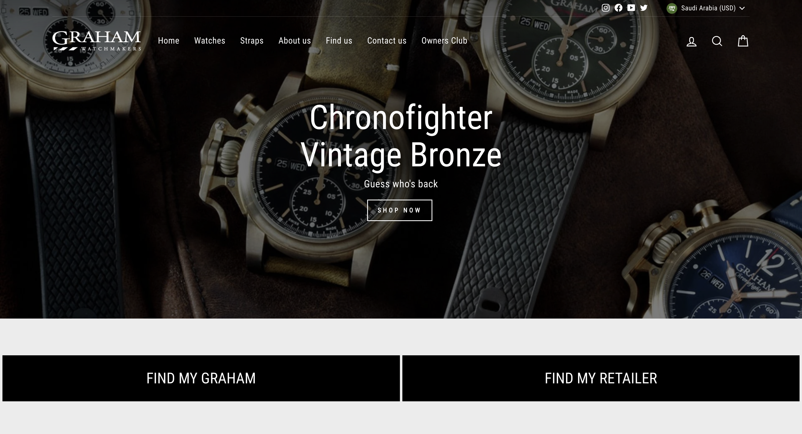
Graham Website

Slide 3
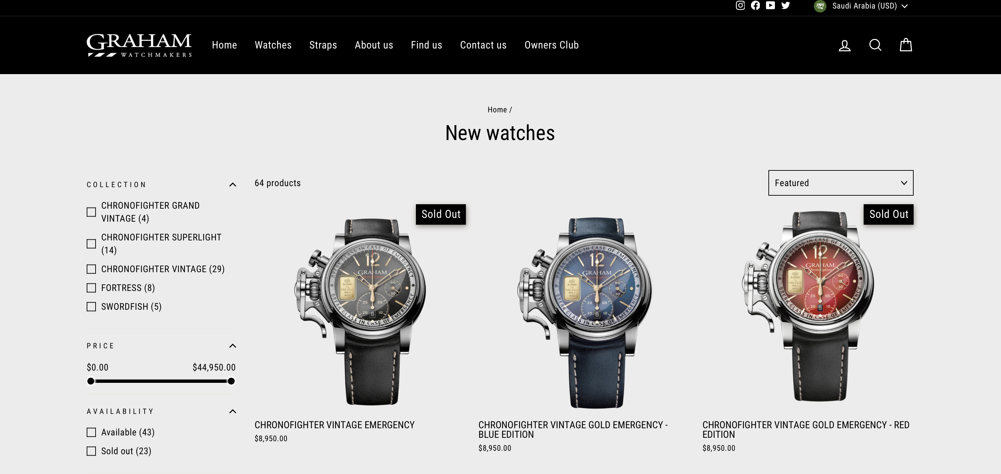
Graham Website

Slide 4
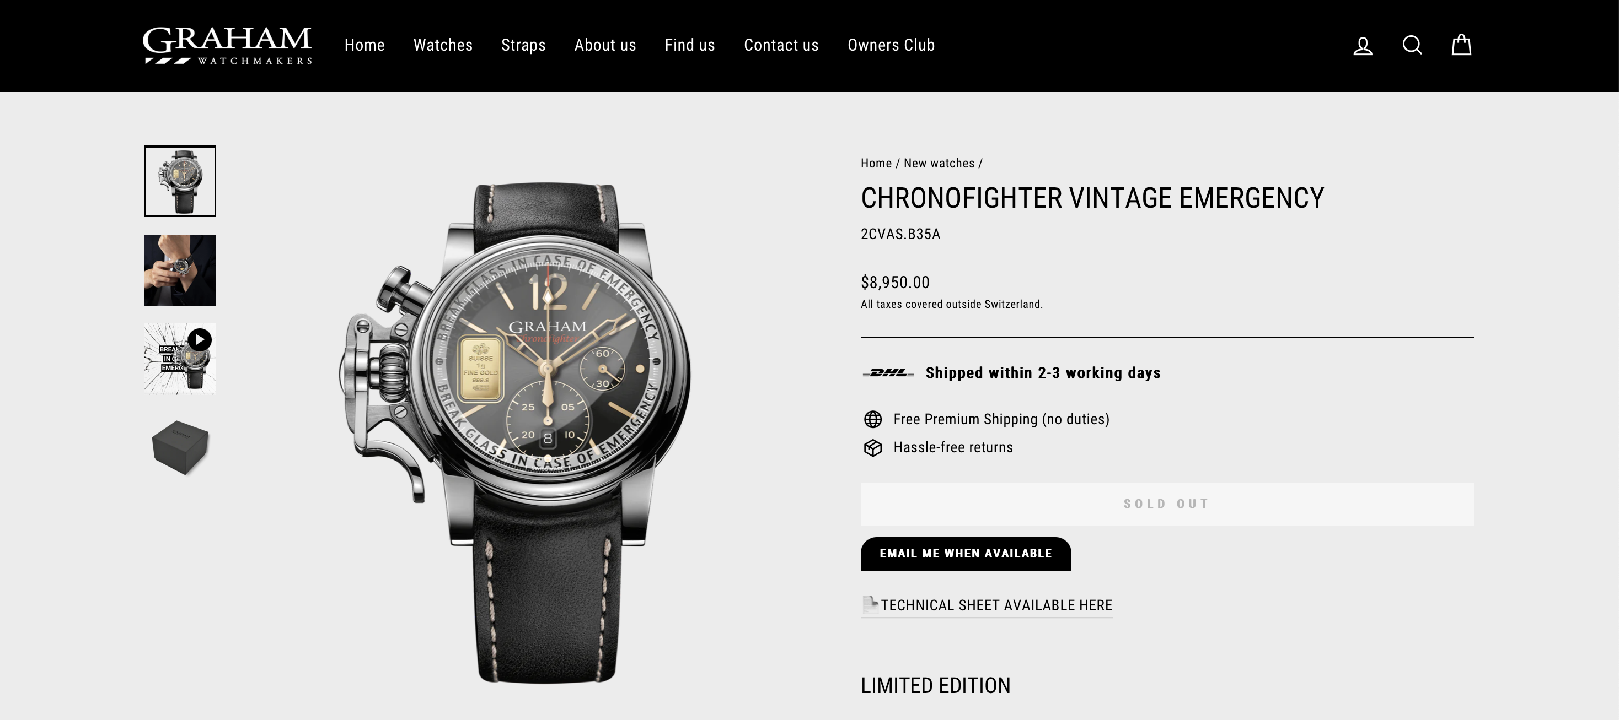
Graham Website

Slide 5
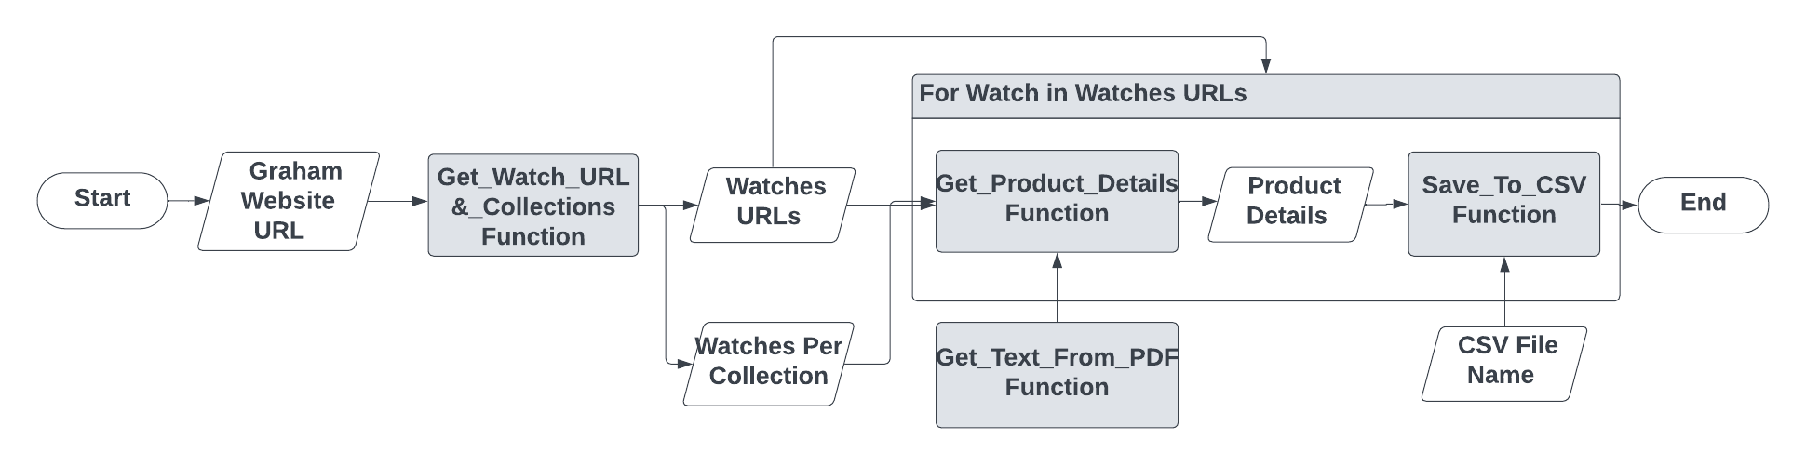
Code Flowchart

Slide 6
Challenges
Parsing the watches’ URLs
Parsing text from PDF
Extracting information from the PDF’s text

Slide 7
Overall: 62% Captured Data With 96% Accuracy

Slide 8
The Highest Percentage Parent Model

Slide 9
The Names & Clasp Type

Slide 10
Which style is more expensive

Slide 11
Thank You For Listening
Any Questions?

